Slide 1
Ecological Family Agroforestry Farming System
David Kulimbao

Slide 2
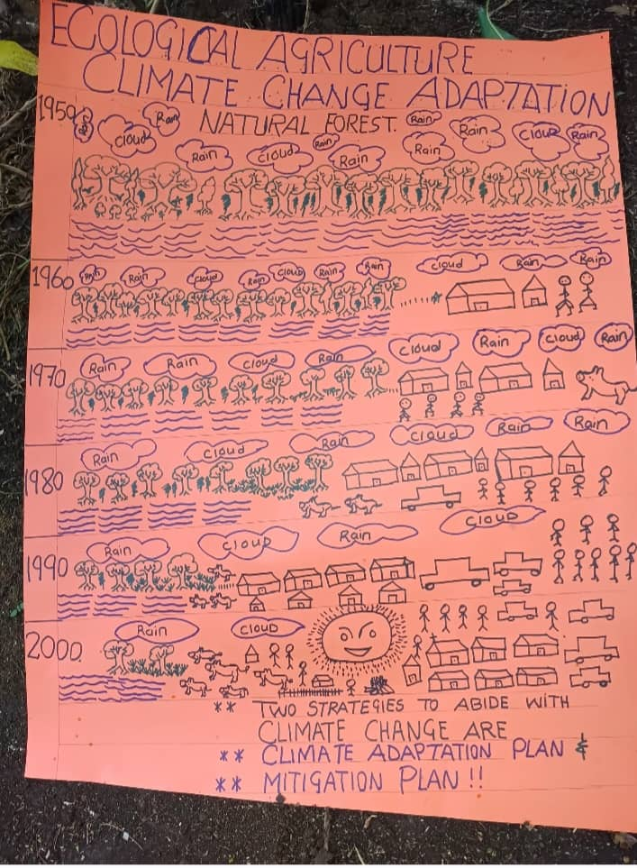
Introduction
This ministry of Family and Community Agroforestry in the Highlands and Sandaun Province, started after the 1997 El-Nino drought
When BUPNG Community Development Team began a Family Agroforestry system to work with those families particularly the women who took most responsibility for local trees, seeds and seedling collection

Slide 3
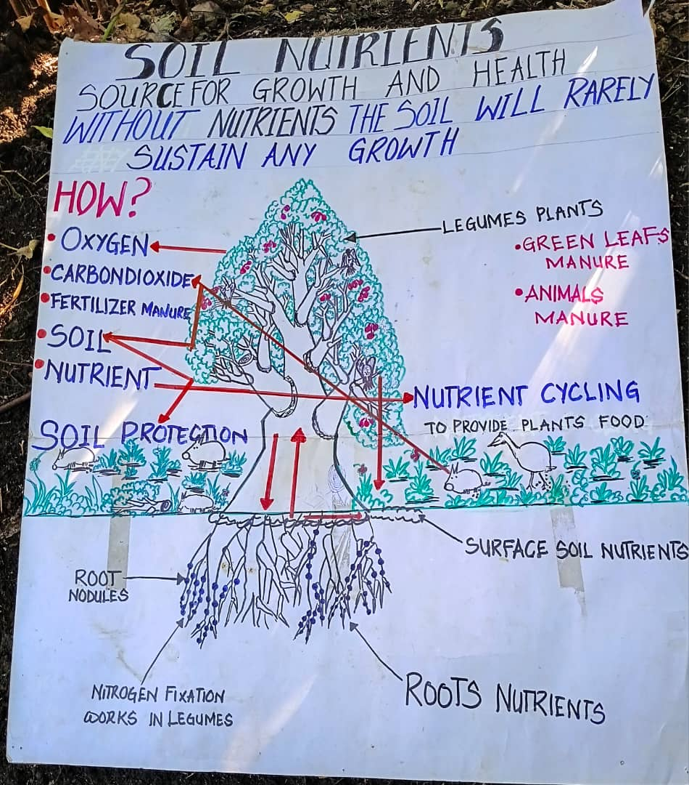
Goals
FAFS, the Family Agroforestry Farming System project began by identifying 10 volunteer farm families in 3 targeted areas who would adopt enterprise into their farming system for:
Quality Subsistence Food Production.
Improve cash-crop production, as timber, fruits, vanilla etc
Improve soil conservation and fertility restoration during fallow

Slide 4
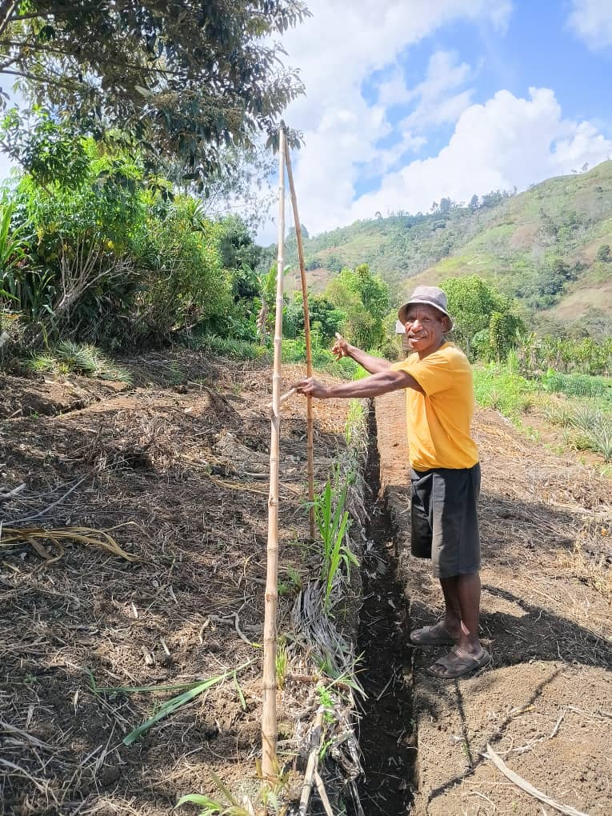
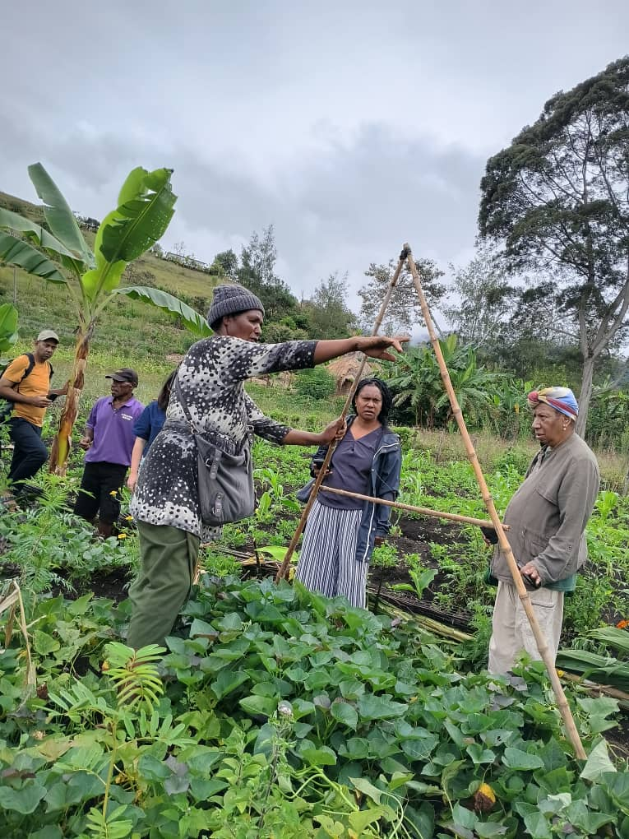
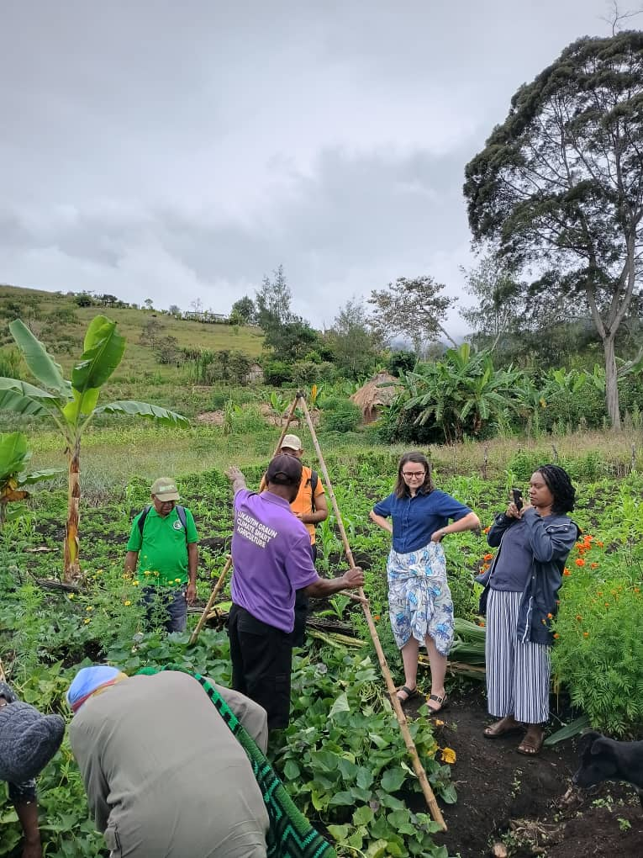
A-Frame (Lukautim Graun)
Contour Marking
Soil is the foundation of you garden. Therefore, we used A-Frame contour marking to rule the garden beds.
Reasons:
Stop soil erosion from heavy rain fall
Making the rain water slow its speed
Planting legumes that can easily produce high quality top organic soil

Slide 5
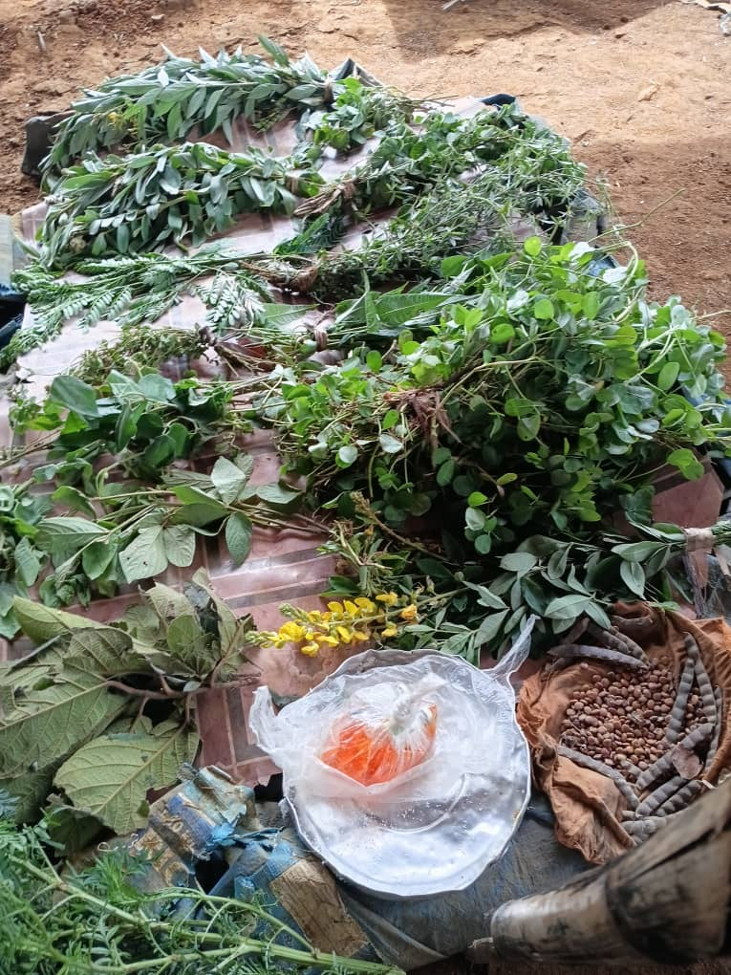
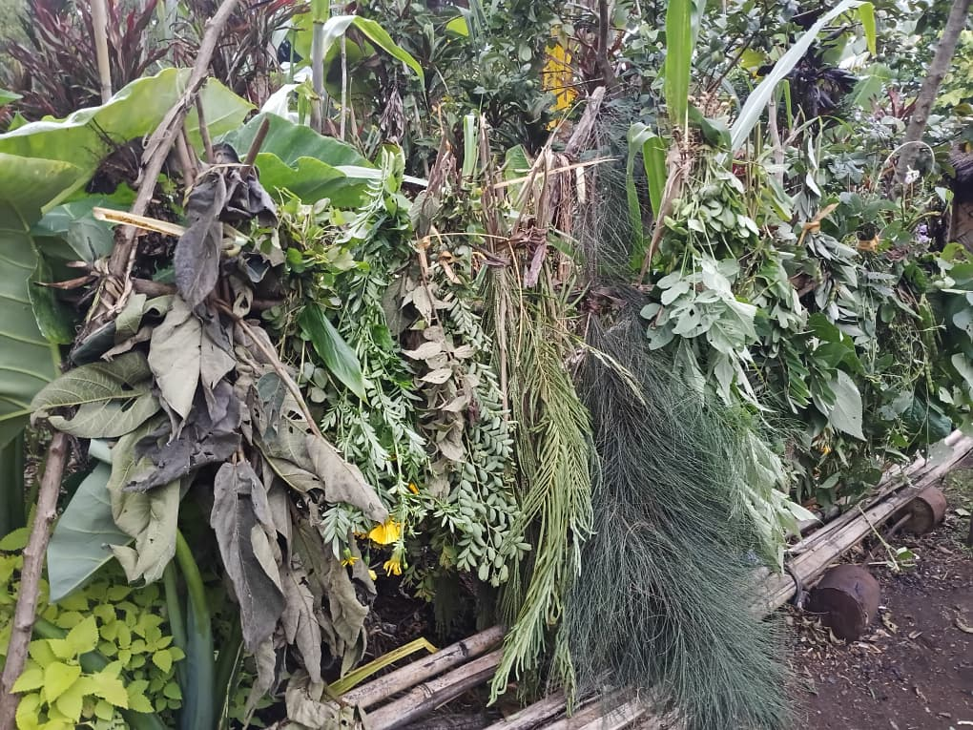
Local Legumes
Local legumes provide soil nutrients
Restore soil fertility
Making top soils black
Less erosion
Improve yields
Little birds and animals are feeding from our garden

Slide 6
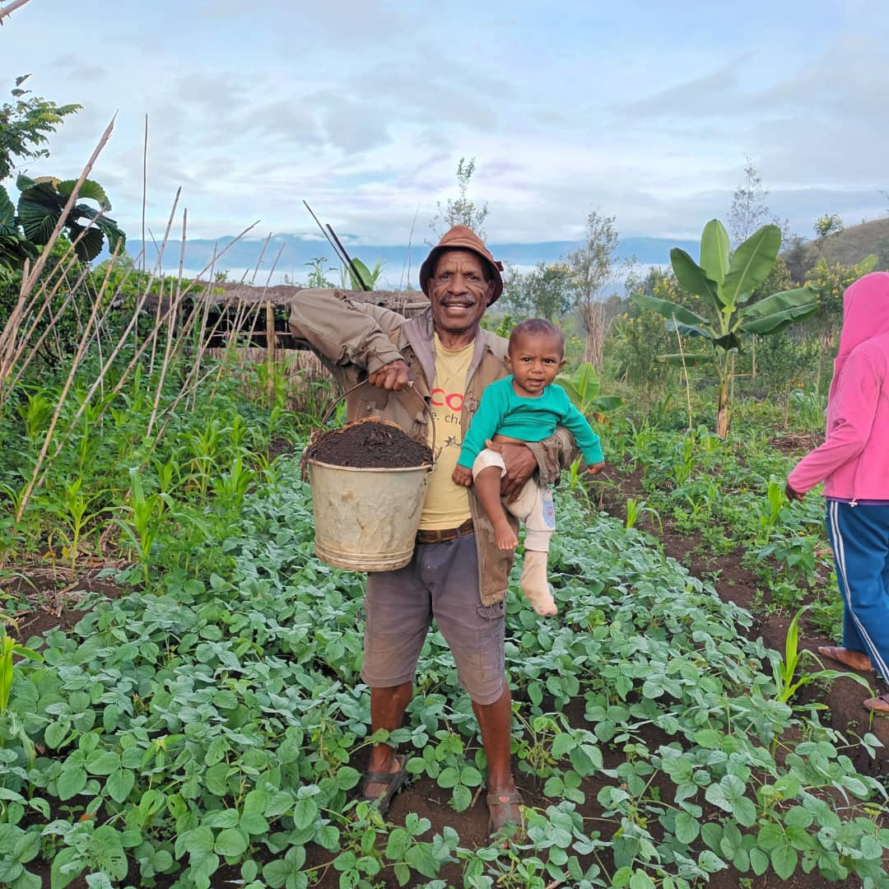
Caring for soil like your own child

Slide 7
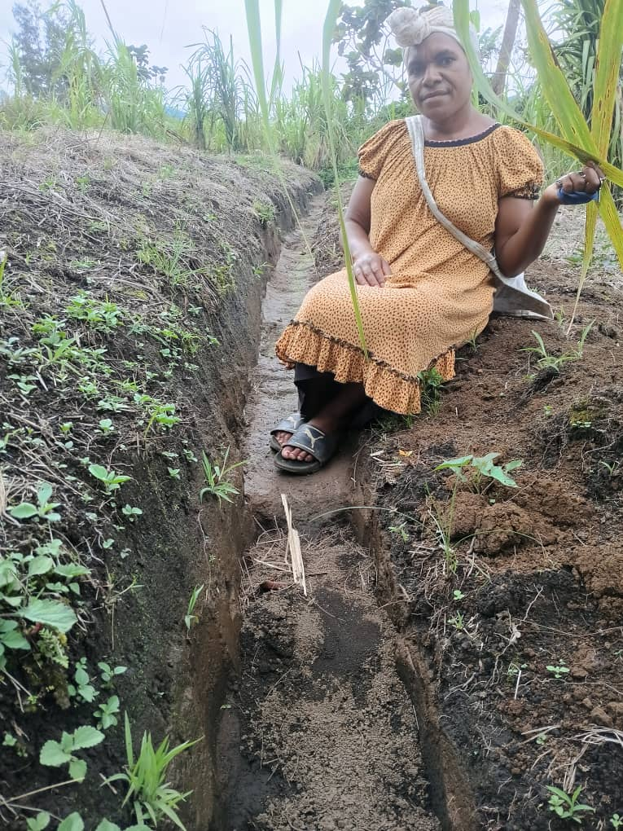
Soil Erosion Control

Slide 8
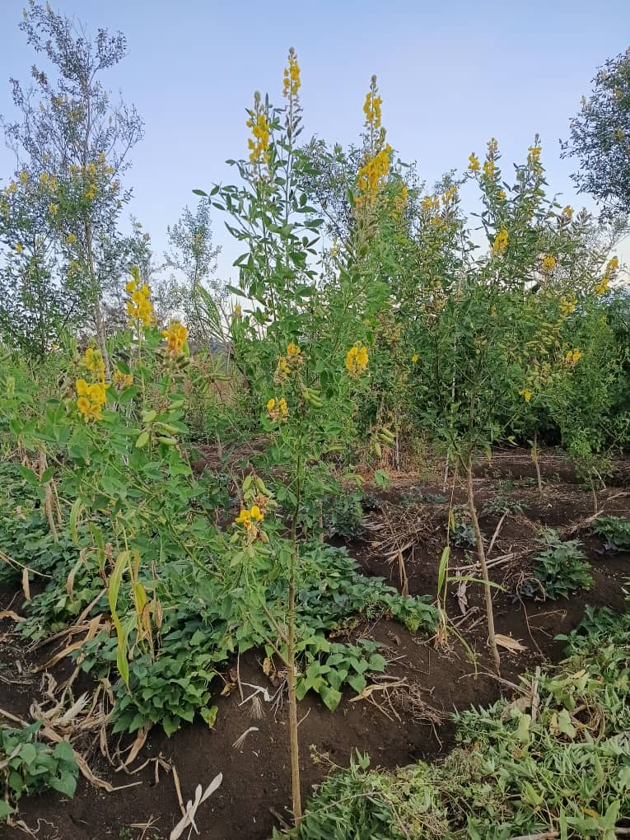
Rows of shrubs for soil improvement

Slide 9
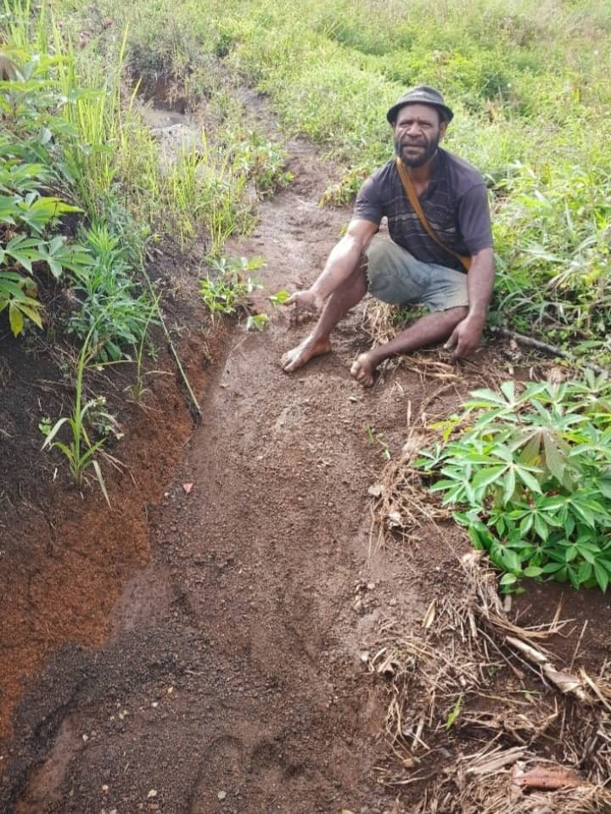
Keeping soil from rain carrying away

Slide 10
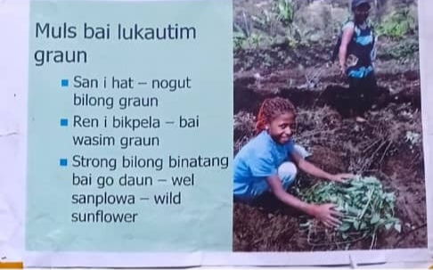
Mulching
Mulching is very important during sun and rain

Slide 11
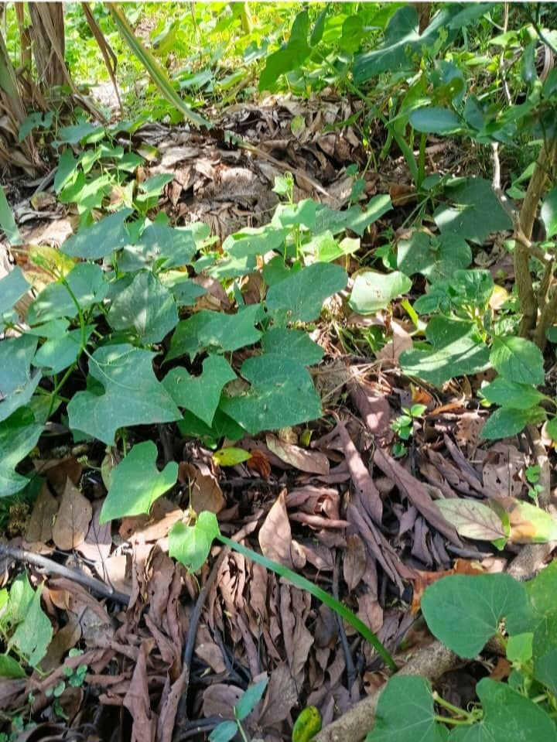
Green Manure

Slide 12
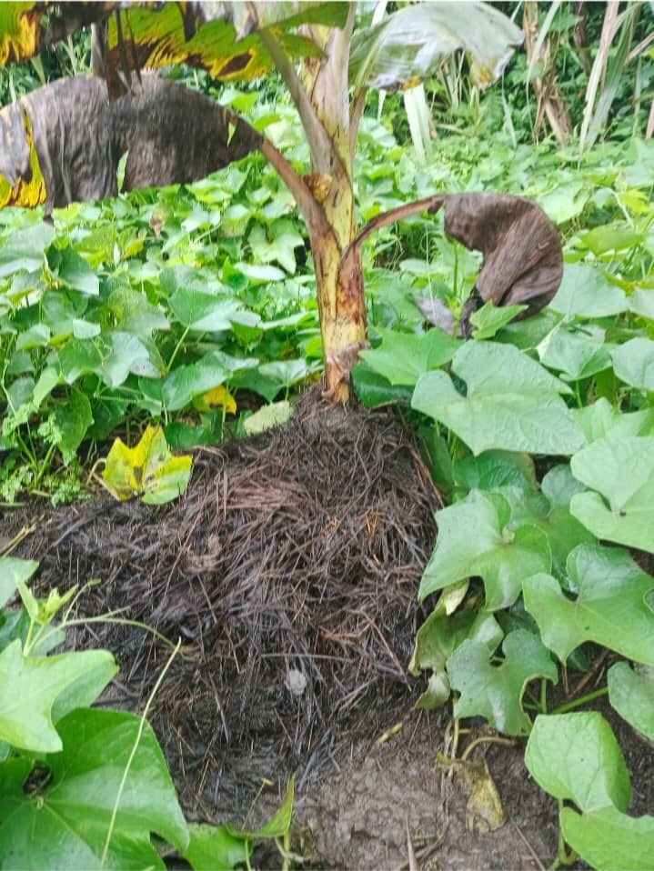
Animal manure works better than NPK

Slide 13
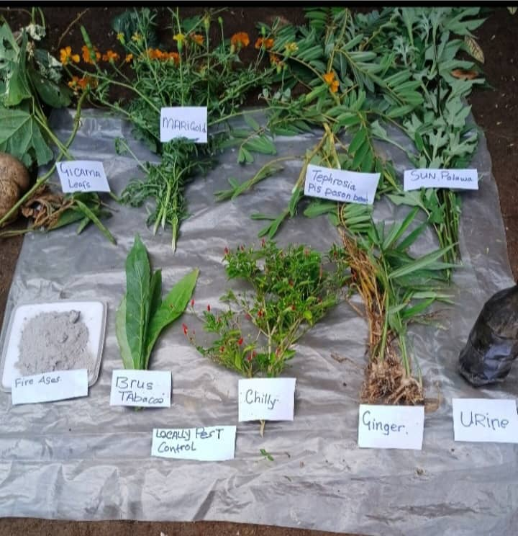
Local Pest Control

Slide 14
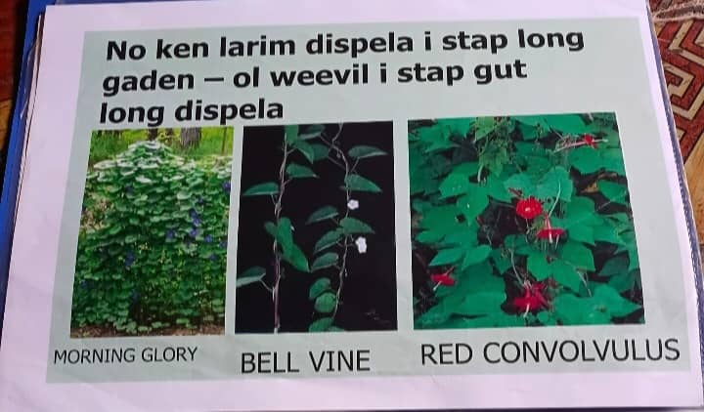
Avoid these plants in your garden

Slide 15
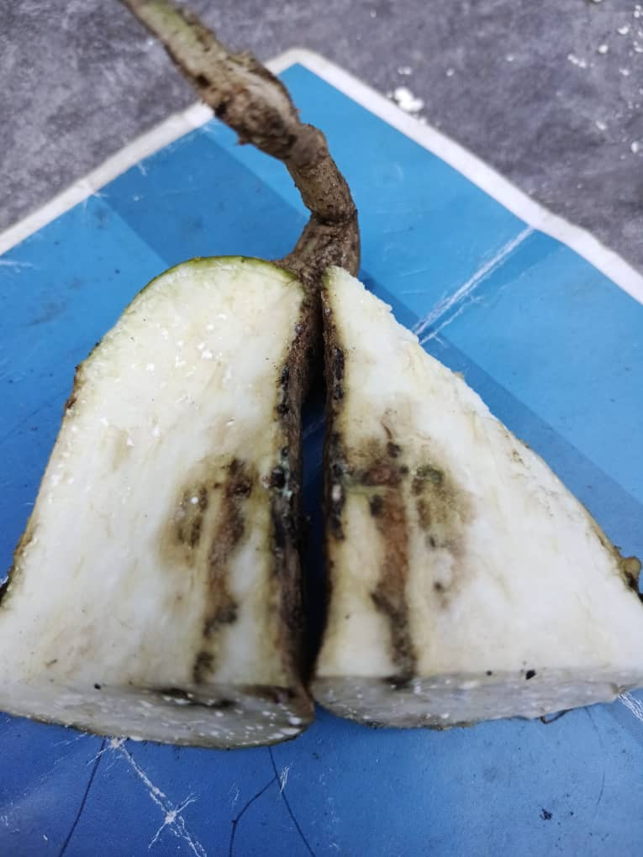
Weevil infection in kaukau (sweet potato)

Slide 16
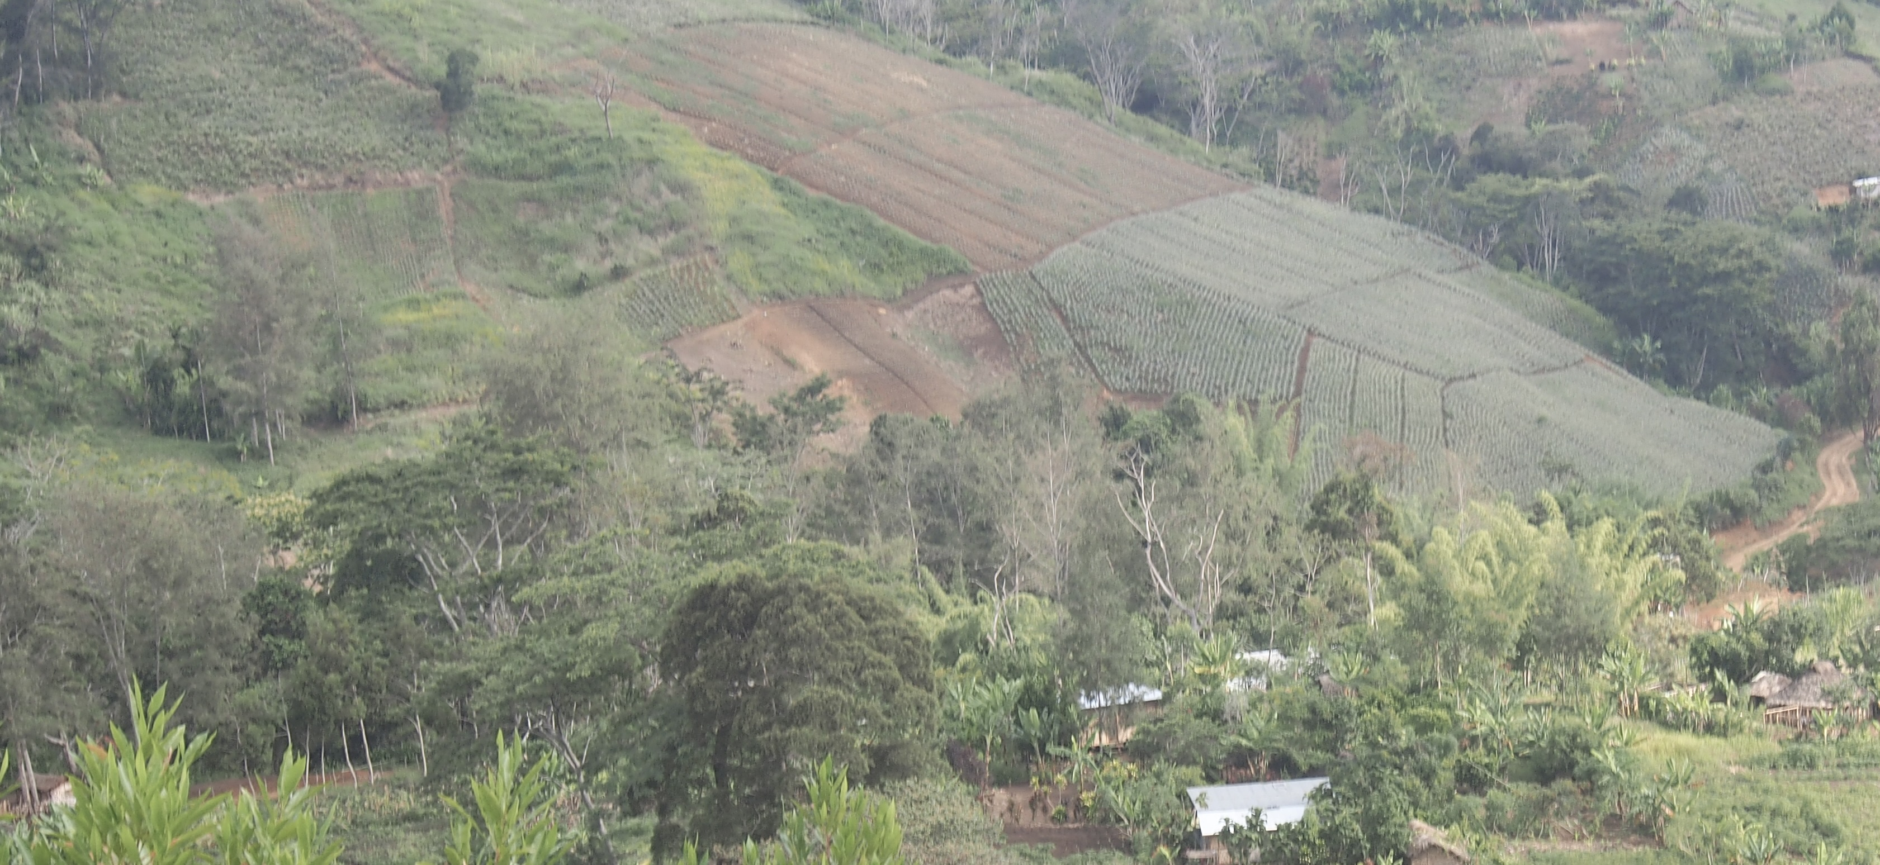
Land without topsoil
See the upper pineapple garden in this photograph shows orange clay soil with little of the original black topsoil

Slide 17
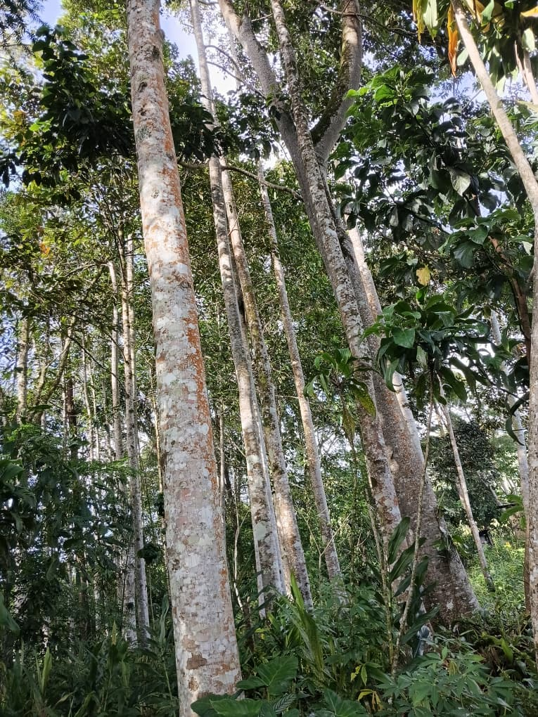
Graun em i Mama bilong yumi. Ol Diwai ol i Papa bilong yumi.

Slide 18
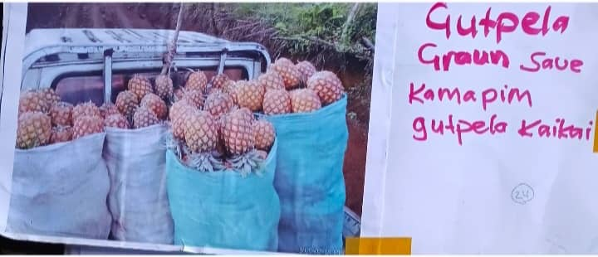
Good soil produce good food

Slide 19
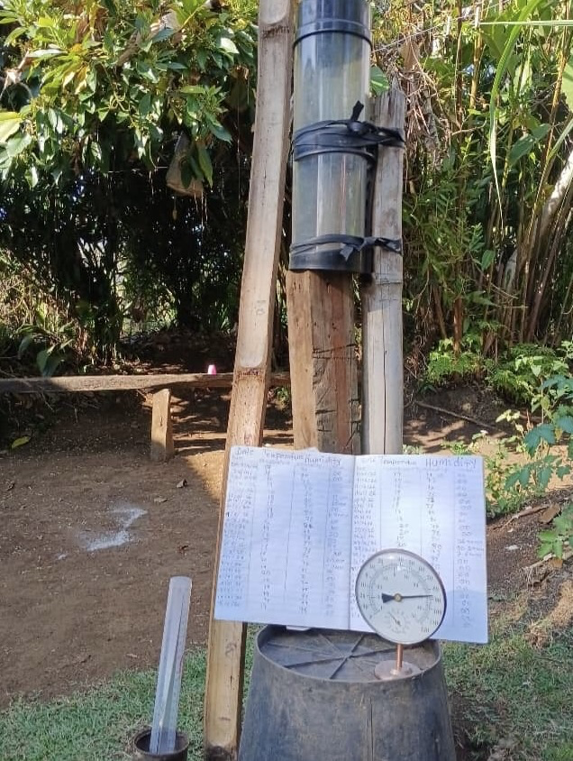
Keep track of your weather using either a simple measuring flask or a more stable Rain Gauge, a Humidity Gauge and a Book to record the daily rainfall and humidity.

Slide 20
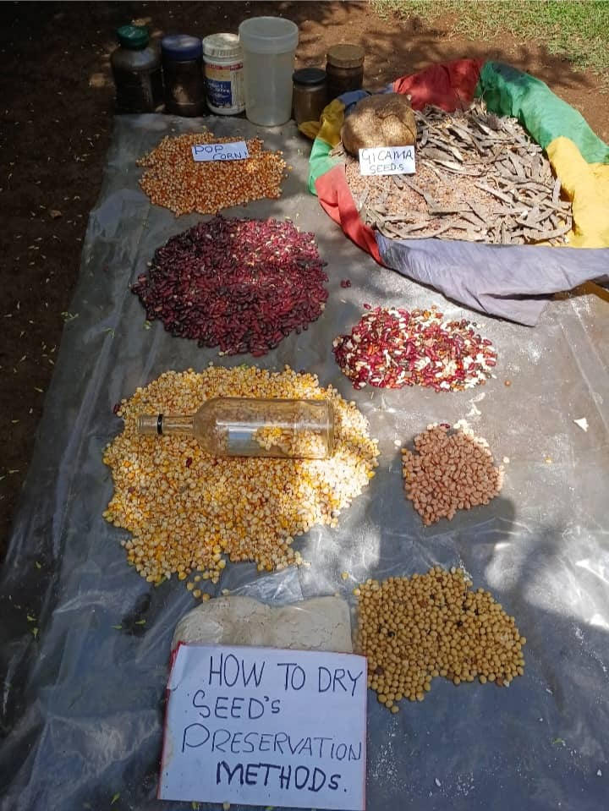
Seed preservation methods

Slide 21
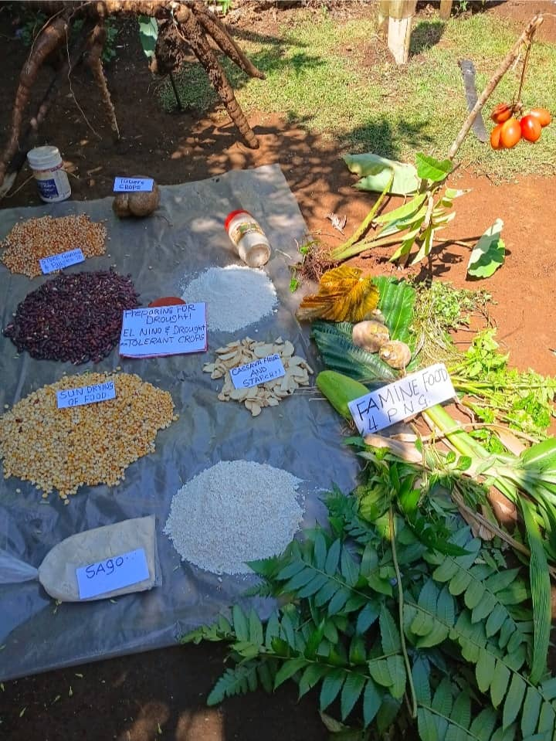
Preparing food for drought (El Nino)
Tolerant crops Famine Food

Slide 22
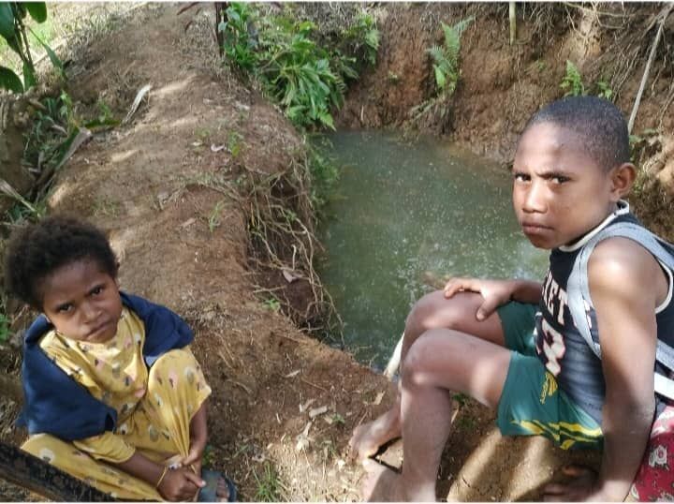
A Tumbuna Well for irrigation or household water

Slide 23
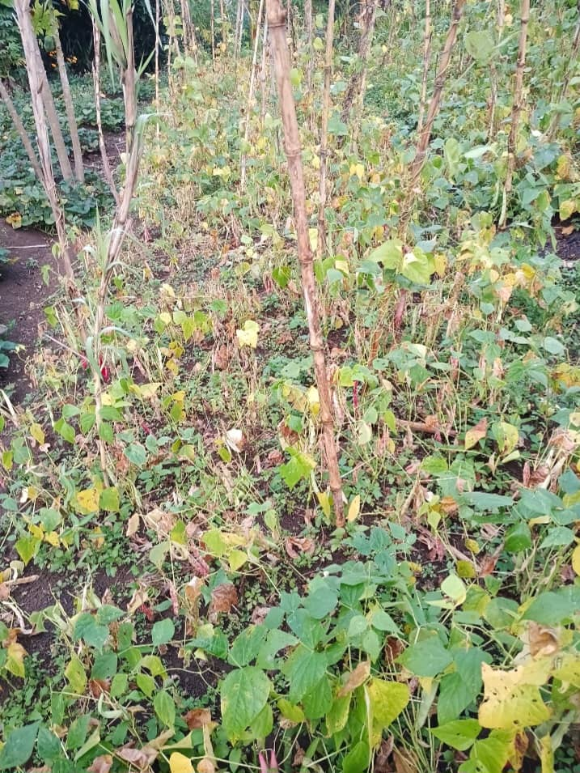
Women all over PNG from year to year watch the plants in their garden. They observed that Changes in Weather Pattern were happening. They were watching climate change take place.

Slide 24
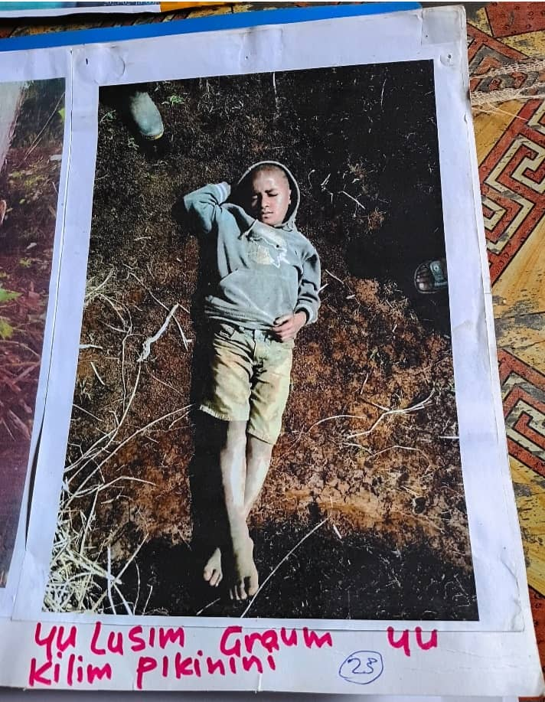
Yu lusim graun, yu kilim pikinini

